Slide 1
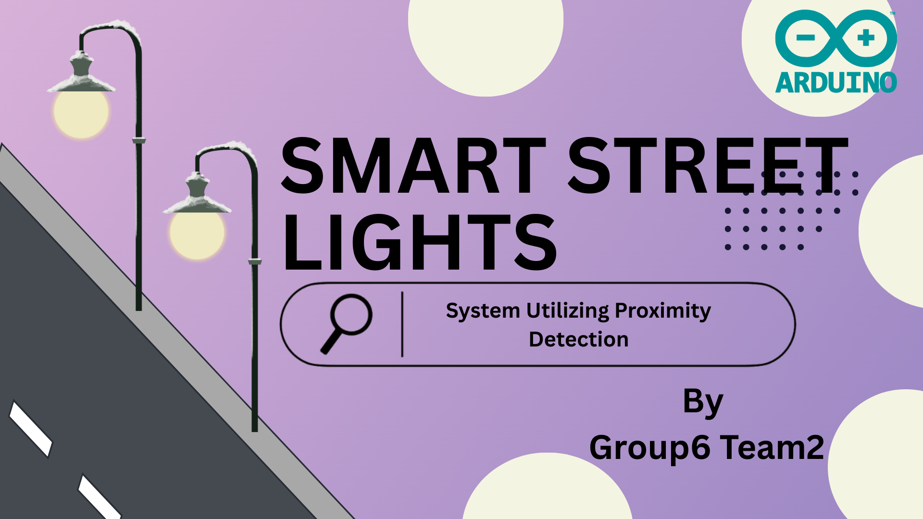

Slide 2
INTRODUCTION
Problem Statement
Traditional streetlights waste energy by staying ON even when not needed.
Proposed Solution
Automatically adjust brightness based on motion detection.

Slide 3
OBJECTIVES
Conserve
Conserve energy by dimming when no motion is detected.
Brighten
Brighten lights when pedestrians or vehicles are nearby.
Ensure
Ensure lights operate only at night.

Slide 4
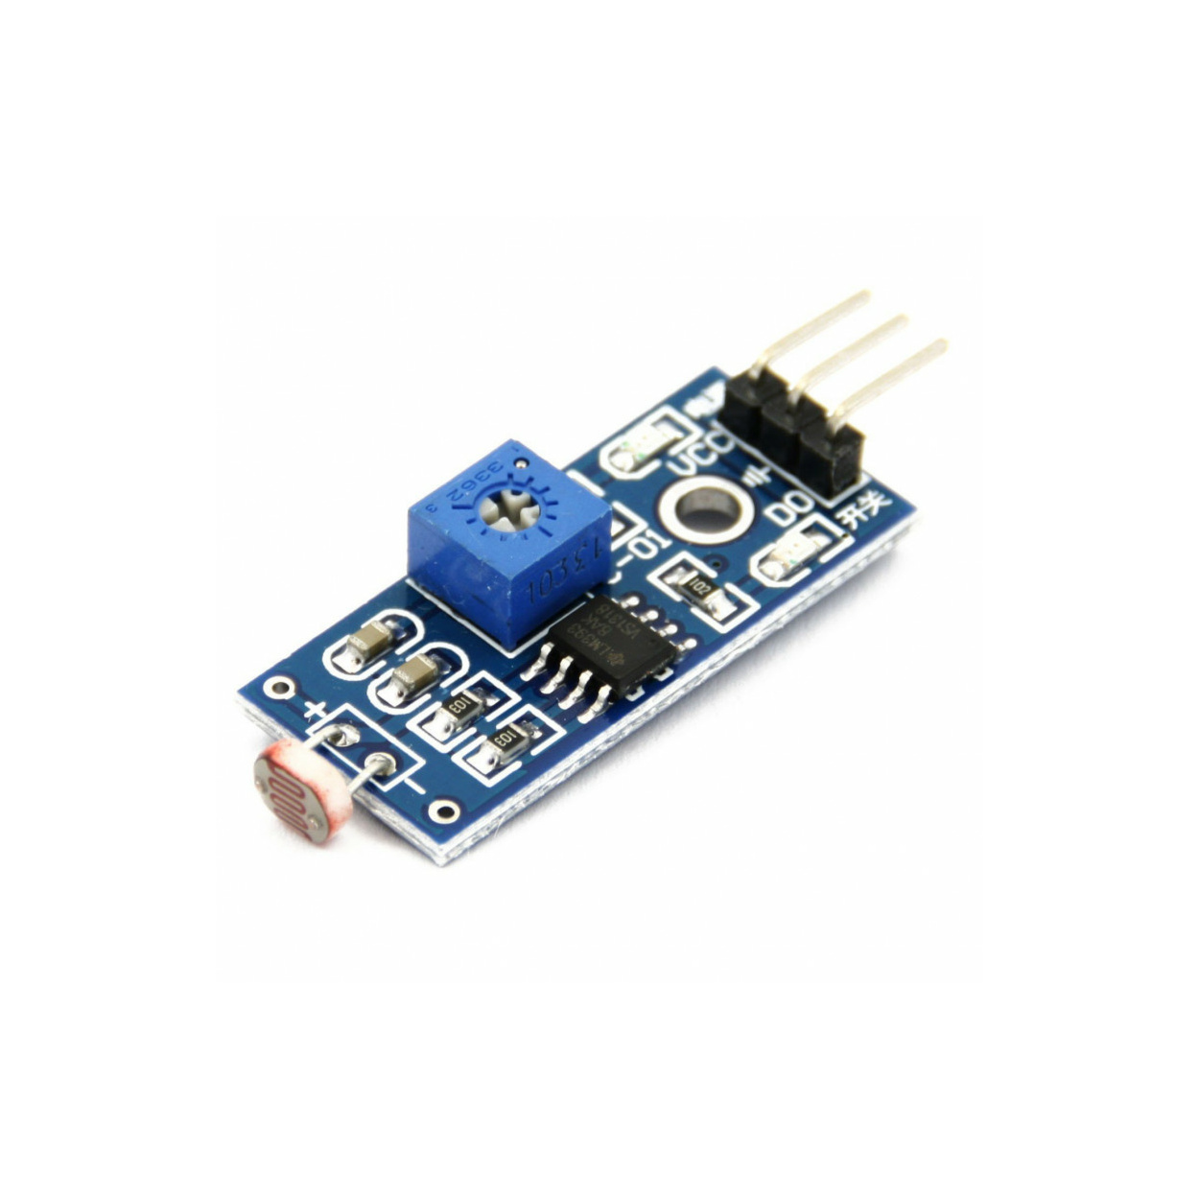
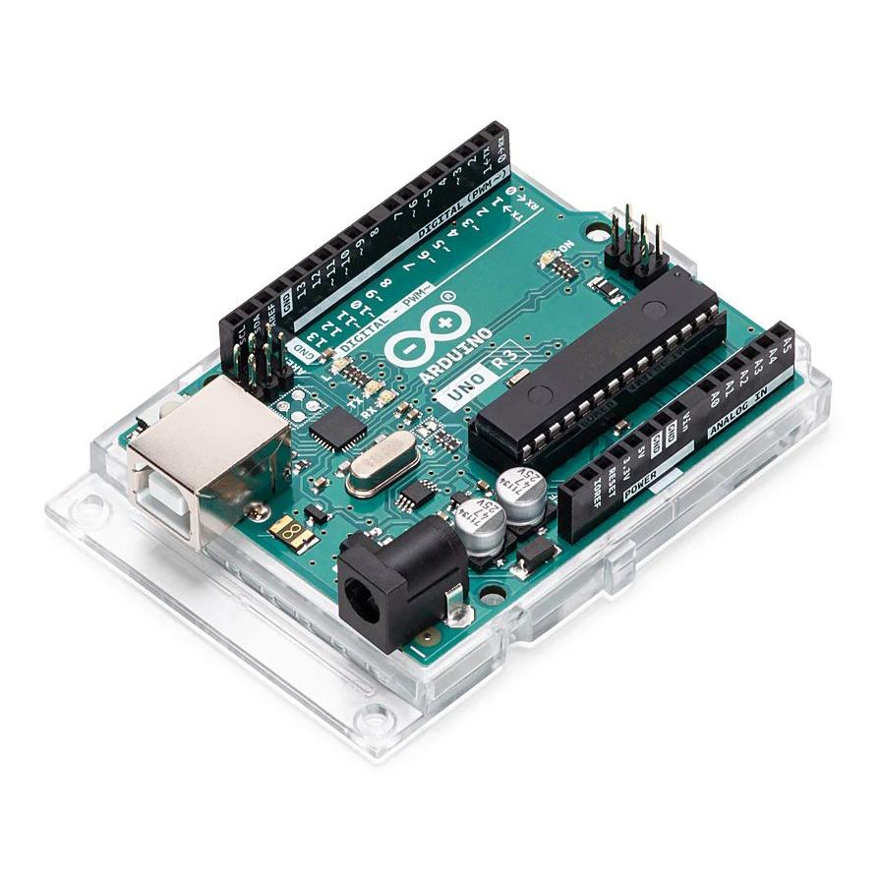
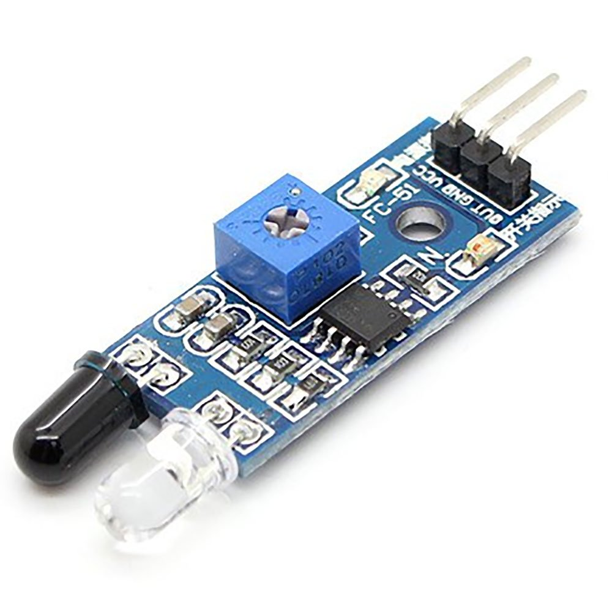
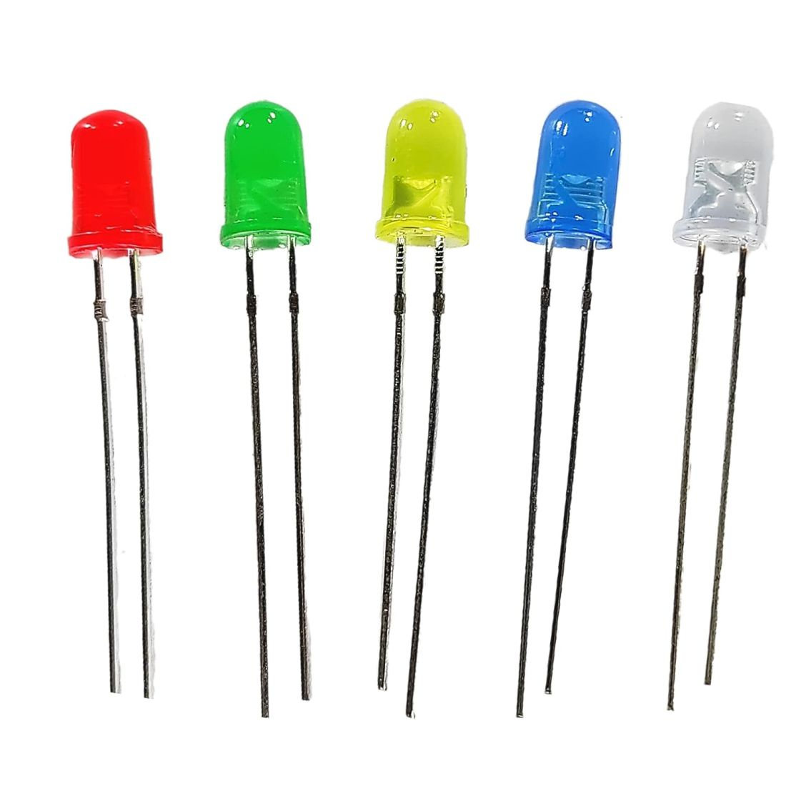
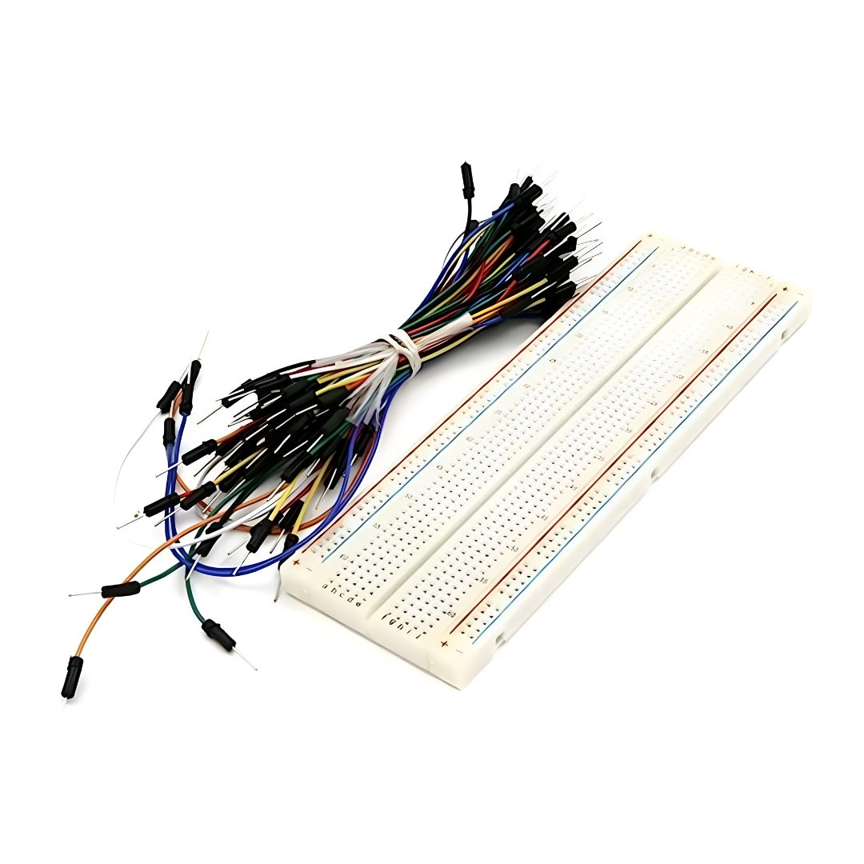
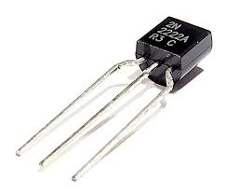
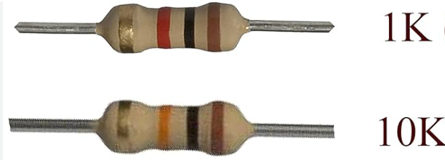
Components required
Arduino UNO/NANO
IR Sensor
LDR
LED
Breadboard and Jumper wires
Resistors
NPN Transistor

Slide 5
BLOCK DIAGRAM
IR Sensor
and LDR
Arduino UNO/NANO
LED BRIGHTNESS CONTROLL
INPUT
MICROCONTROLLER
OUTPUT

Slide 6
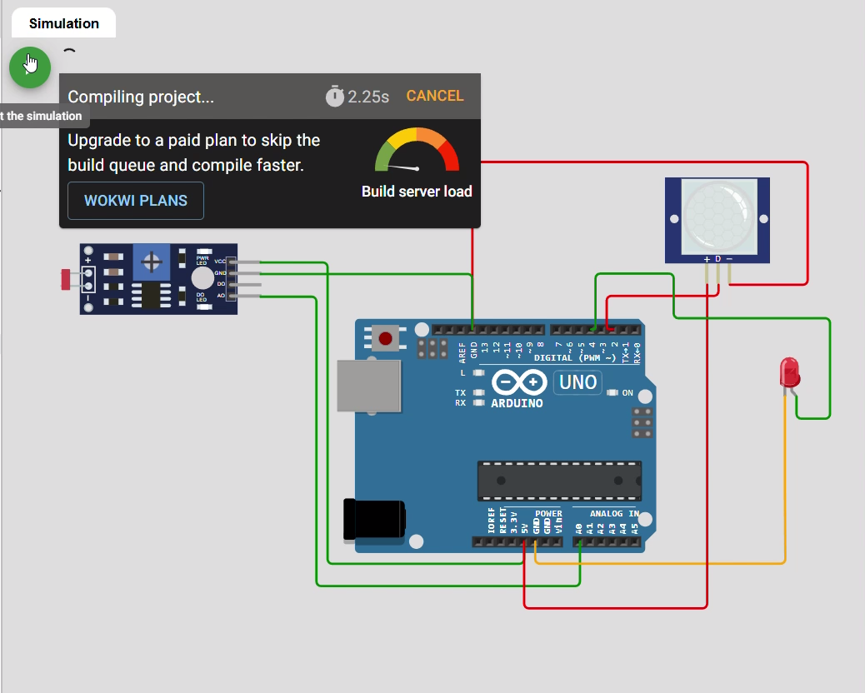
CIRCUIT
Stimulated using Wokwi

Slide 7
WORKING PRINCIPLE
Idle (No Motion):
LED stays dim (low brightness).
Motion Detected:
LED turns to full brightness.
Daytime :
LED remains off regardless of motion.

Slide 8
ADVANTAGES
Saves Energy.
Cost-effective and easy to install.
Low maintenance.
Can be upgraded to smart city IoT networks.

Slide 9
FUTURE ENHANCEMENTS
Integrate solar panels.
Add IoT (Wi-Fi/Bluetooth) for remote monitoring.
Real-time data logging (e.g., how many times motion detected).

Slide 10
THANK YOU - NIKHITA , PRANEETHI , NAVYA , SHIVA , UMESH

